Slide 1
Super Resolution
Via Zhichao Fu
Intro

Slide 2
Image Degradation & Restoration

Slide 3

Image Degradation Model
An ill-posed problem: Variable combination of degradation kernel and can cause different kind of information loss, damage to natural images.
$$D=K⊗I+N$$
Blind Degradation Kernel (Convolution)
Additional Noise
Blur -Motion
Downsample -Thumbnail
Compress -JPEG
…
Gaussian
Gamma
Impulse
…

Slide 4
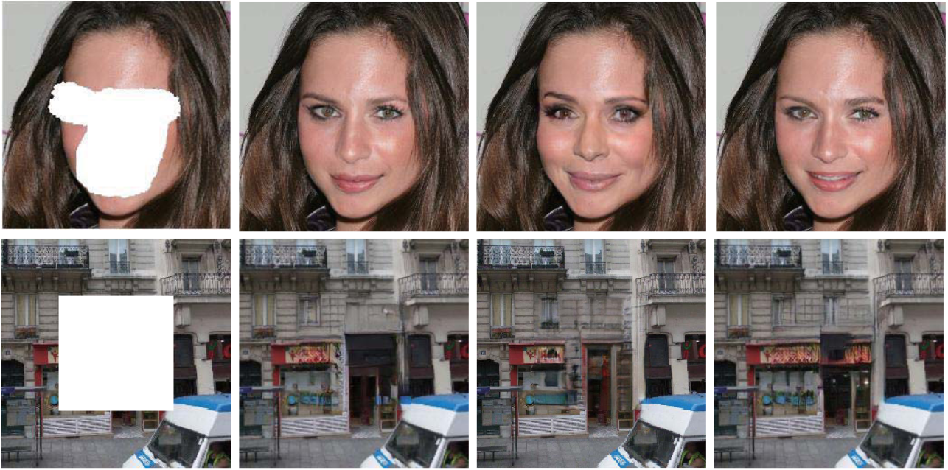

Image Restoration Tasks
Main Goal:
Generate an utmost approximate solution of original image.
Restore the loss of information.
$$D=K⊗I+N$$
Inpainting
Super Resolution
Denoising
Deblurring
Demosaicing
De-hazing, De-raining, De-snowing…
Artifact Removal
……

Slide 5
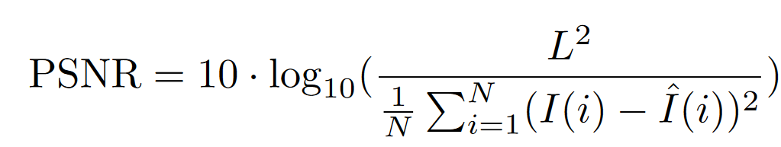
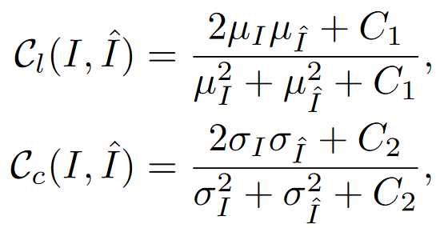
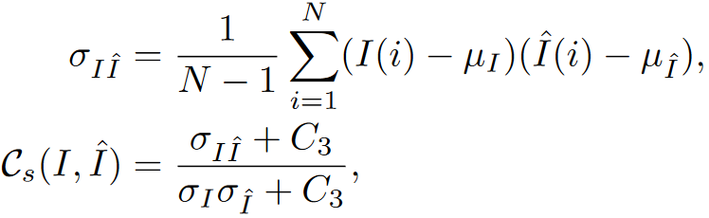
Image Quality Assessment
Full-Reference Metrics: PSNR, SSIM
Subjective Index: MOS
Pre-processing Task Test: Object Detection & Recognition
Luminance
Contrast
Structure

Slide 6
Super Resolution

Slide 7
Image Downsampling
Pattern changed during downsampling
1 | 1 | 1 | 1
0 | 0 | 0 | 0
0 | 0 | 0 | 0
1 | 1 | 1 | 1
Interpolation
Pooling
Stride Convolution
……
.5 | .5
.5 | .5

Slide 8
Image Downsampling
Downsampling models in SR
Bicubic (BI):
Only Bicubic interpolation
Blur & Downsampling (BD):
Gaussian Blur (kernel size=7, standard deviation=1.6)
Bicubic interpolation
Downsampling & Noise (DN):
Bicubic interpolation
Gaussian Noise (level=30)

Slide 9


Super Resolution
Common Traditional Method:
Interpolation (Nearest/Bilinear/Bicubic)
Learning-based (Sparse code)
Super Resolution
(Enlarge Size & Enrich Info)
Low Resolution(LR)
High Resolution(HR)

Slide 10
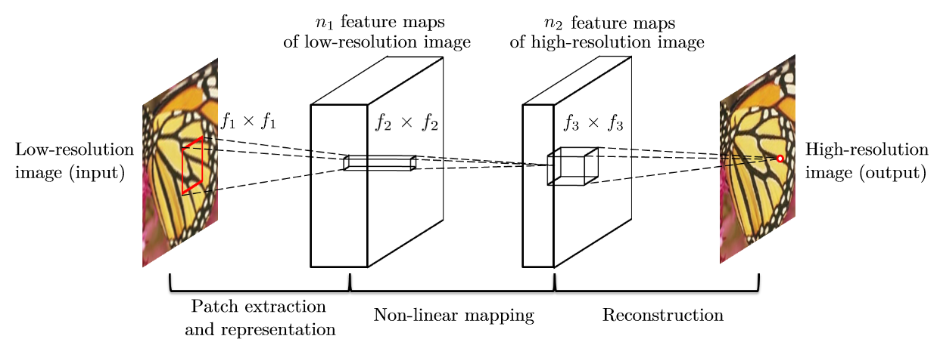
Early Deep Learning Super Resolution Work (SRCNN)
Upsample(Bicubic)
Network
Dong C , Loy C C , He K , et al. Image Super-Resolution Using Deep Convolutional Networks[J]. 2014.

Slide 11
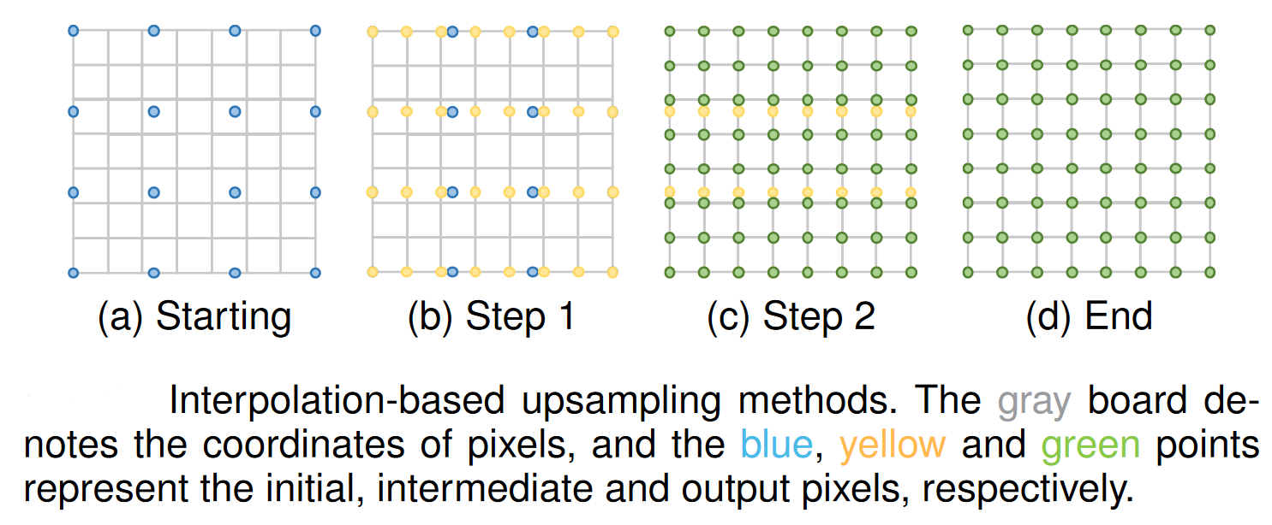
Upsampling Operations in Super Resolution
Interpolation (Issue: blur)

Slide 12
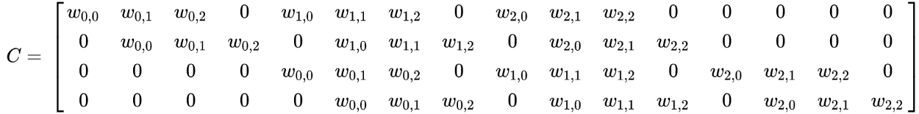
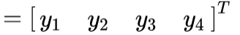
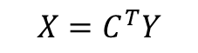


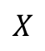
Upsampling Operations in Super Resolution
Transposed Convolution (Issue: checkboard artifact, fixed scale)
Kernel
HR
$$X$$
LR
$$Y$$
Convolution
$$Y=CX$$
Transposed Convolution
$$X=C^{T}Y$$

Slide 13
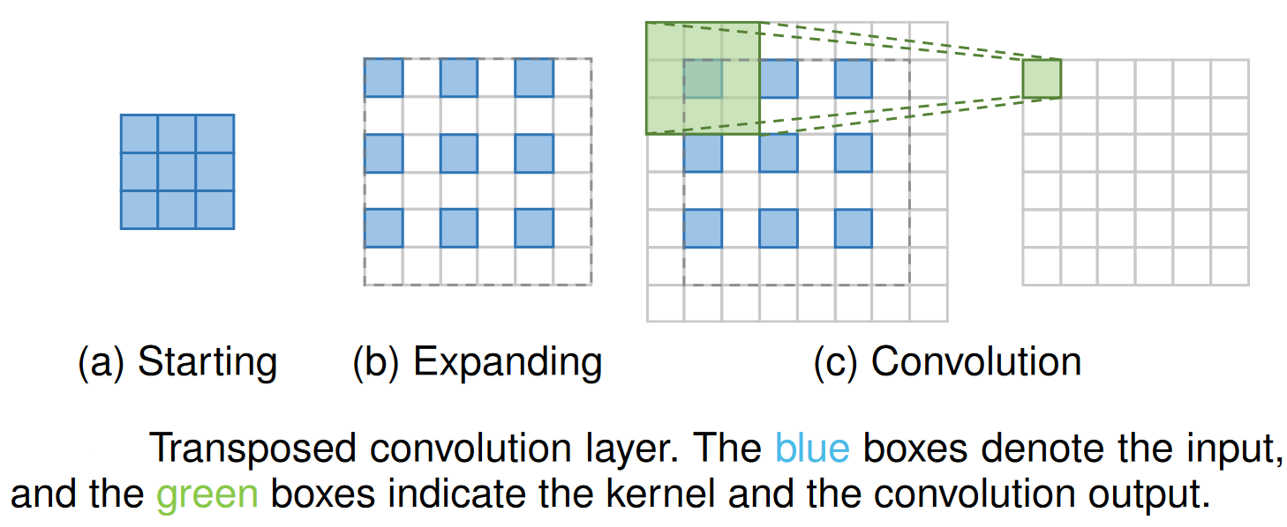
Upsampling Operations in Super Resolution
Transposed Convolution (Issue: checkboard artifact, fixed scale)

Slide 14
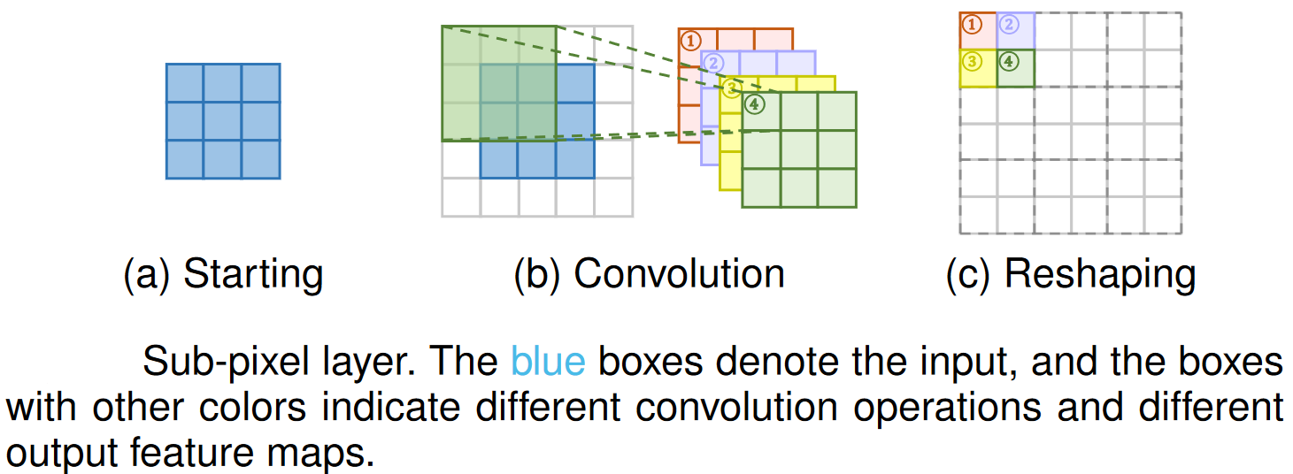
Upsampling Operations in Super Resolution
Sub-pixel Layer (Convolution & PixelShuffle, Issue: block border, fixed scale)

Slide 15
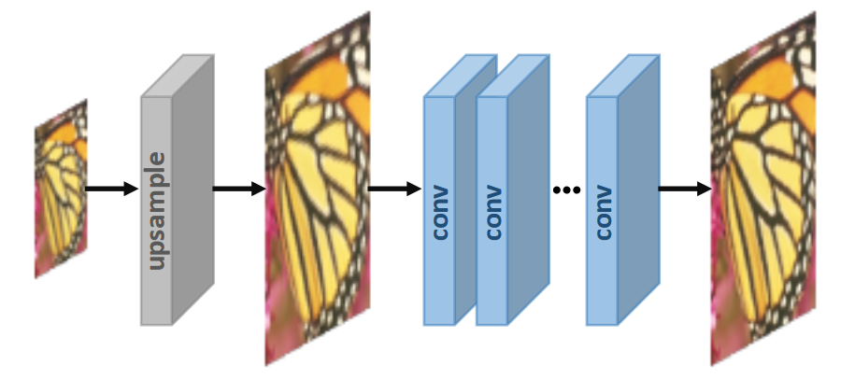
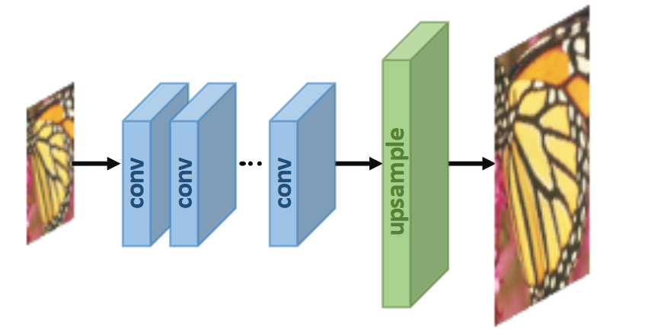
Common Framework
Pre-upsampling & Post-upsampling
Pre-upsampling
Post-upsampling

Slide 16
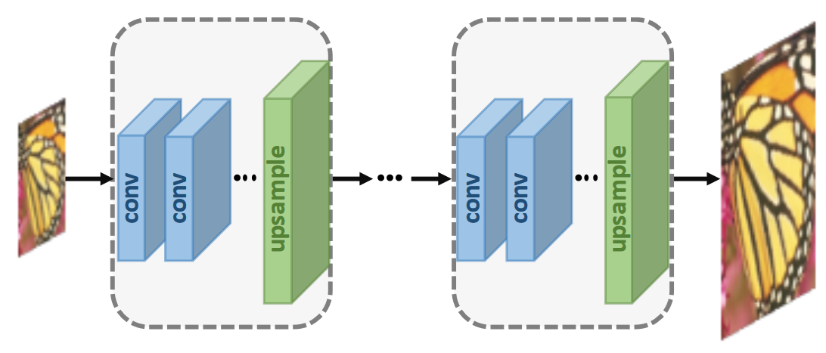
Common Framework
Progressive Upsampling (Cascaded)
[1] Lai W S, Huang J B, Ahuja N, et al. Deep laplacian pyramid networks for fast and accurate super-resolution[C. IEEE CVPR. 2017.
[2] Lai W S , Huang J B , Ahuja N , et al. Fast and Accurate Image Super-Resolution with Deep Laplacian Pyramid Networks[J]. IEEE TPAMI, 2018.
[3] Wang Y , Perazzi F , Mcwilliams B , et al. A Fully Progressive Approach to Single-Image Super-Resolution[C]. IEEE/CVF CVPRW, 2018.

Slide 17
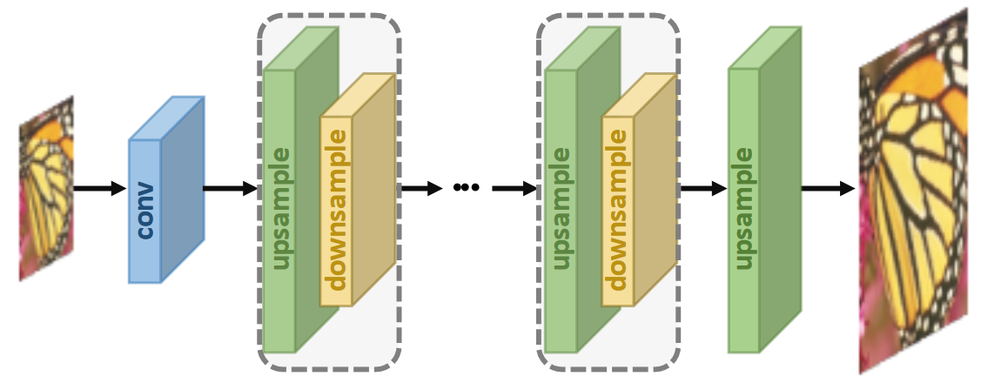
Common Framework
Iterative Up-and-down Sampling
[1] Haris M, Shakhnarovich G, Ukita N. Deep back-projection networks for super-resolution[C]. IEEE CVPR. 2018.
[2] Li Z, Yang J, Liu Z, et al. Feedback network for image super-resolution[C]. IEEE CVPR. 2019.
[3] Haris M, Shakhnarovich G, Ukita N. Recurrent back-projection network for video super-resolution[C]. IEEE CVPR. 2019.

Slide 18
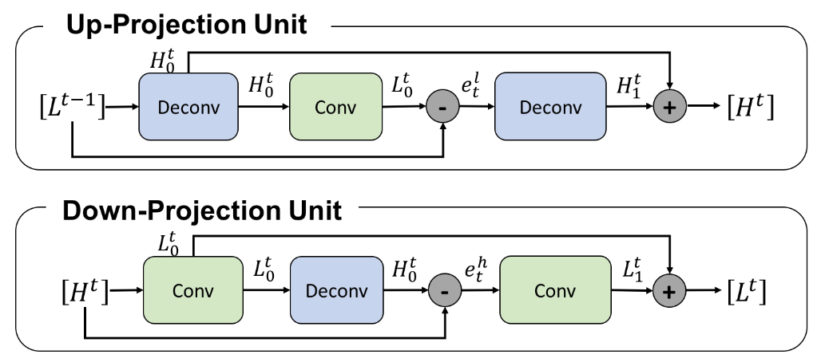
Common Framework
Iterative Up-and-down Sampling
Up- and Down-projection unit proposed in DBPN
[1] Haris M, Shakhnarovich G, Ukita N. Deep back-projection networks for super-resolution[C]. IEEE CVPR. 2018.

Slide 19
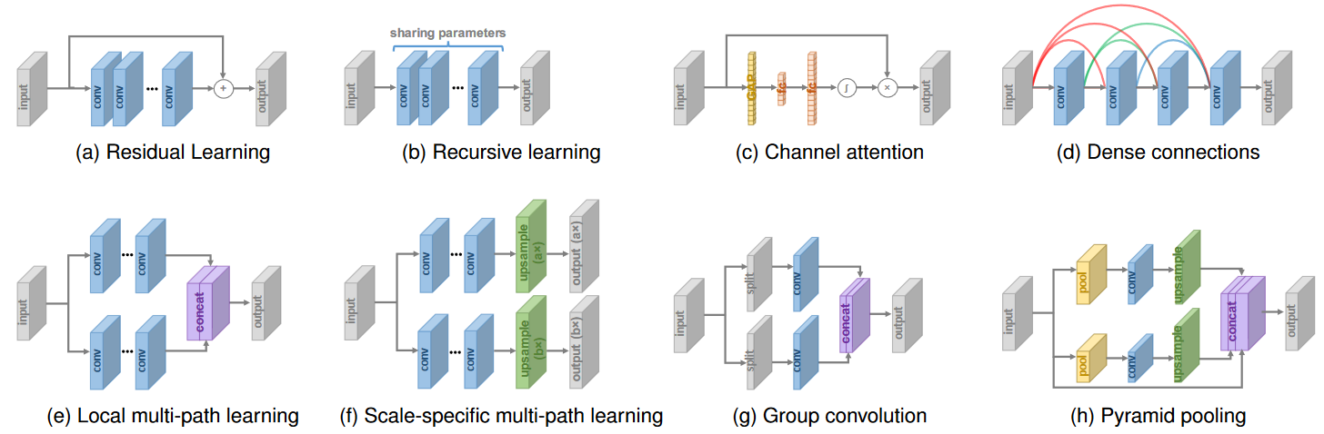
Architecture Design
ResNet
SENet
DenseNet
Inception
RFBNet
PSPNet

Slide 20
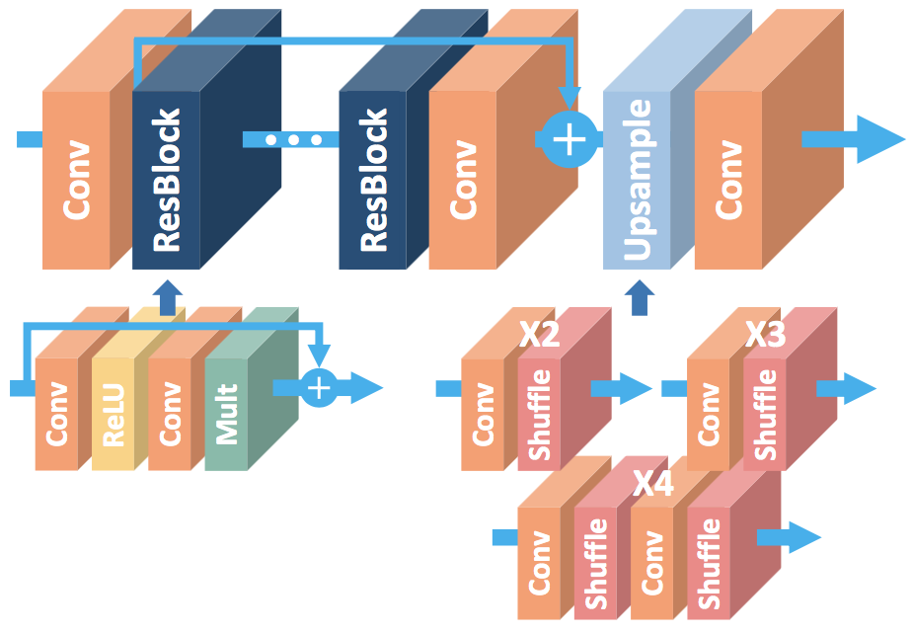
Architecture Design: Residual Connection
EDSR
Lim B, Son S, Kim H, et al. Enhanced deep residual networks for single image super-resolution[C]. IEEE CVPRW. 2017.

Slide 21
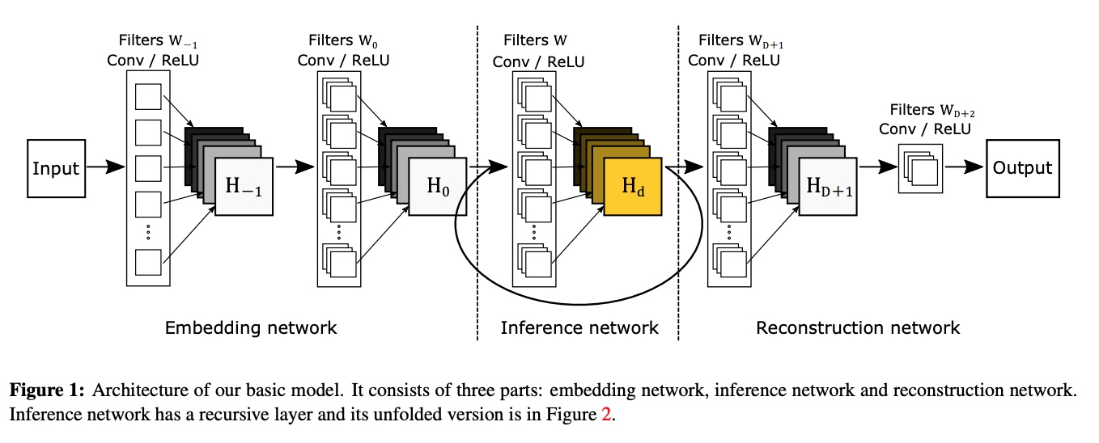
Architecture Design: Recursive Learning
DRCN
Kim J, Kwon Lee J, Mu Lee K. Deeply-recursive convolutional network for image super-resolution[C]. IEEE CVPR. 2016

Slide 22
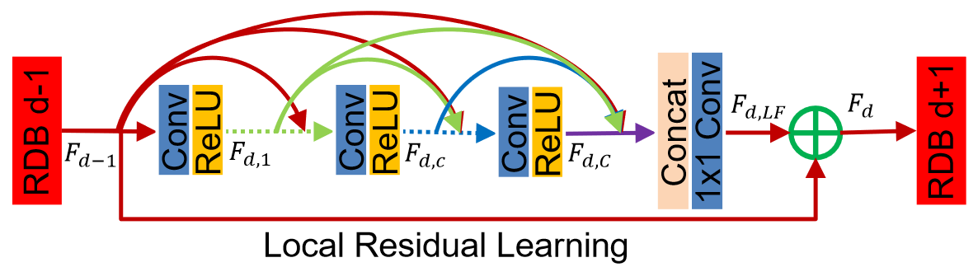
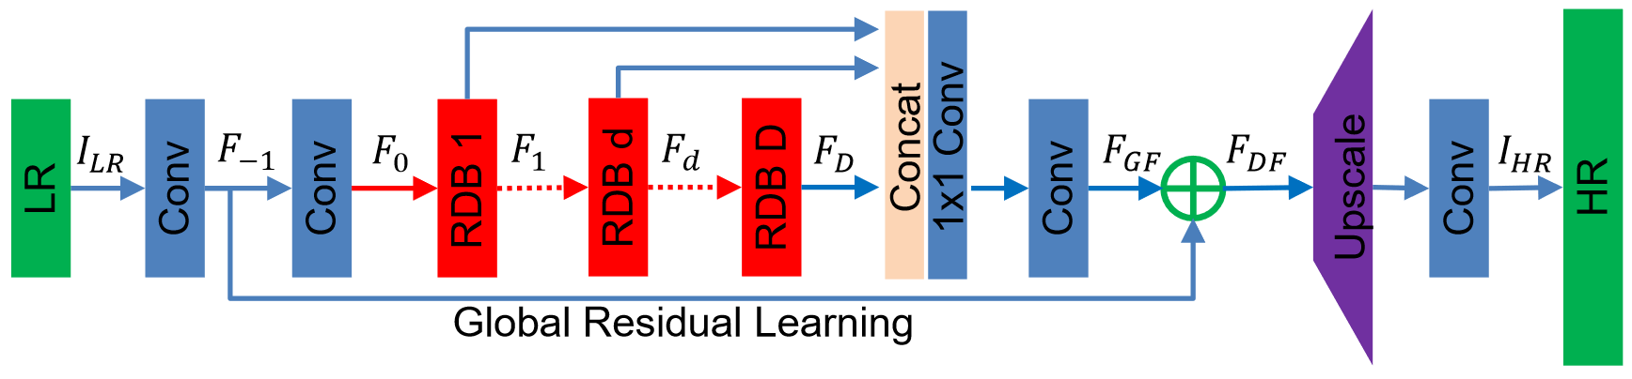
Architecture Design: Dense Connection
RDN
Zhang Y, Tian Y, Kong Y, et al. Residual dense network for image super-resolution[C]. IEEE CVPR. 2018

Slide 23
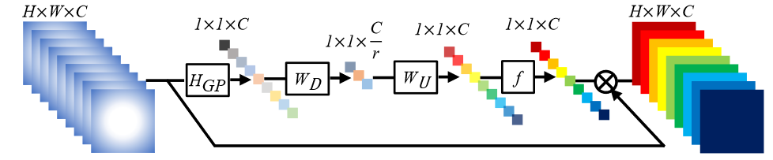
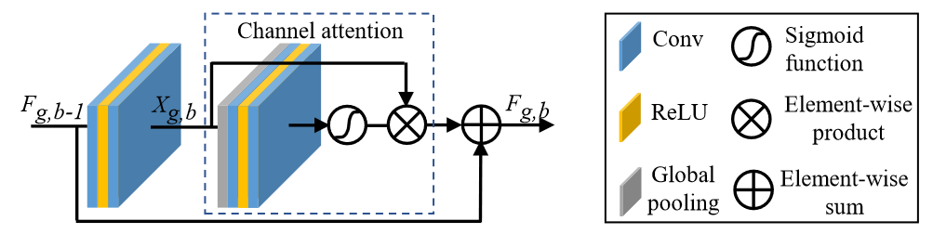
Architecture Design: Channel Attention
RCAN
Zhang Y, Li K, Li K, et al. Image super-resolution using very deep residual channel attention networks[C]. ECCV. 2018

Slide 24
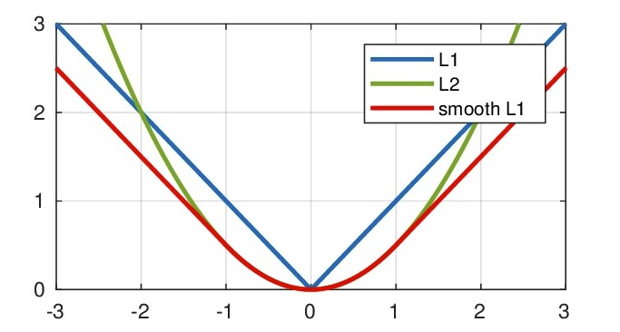
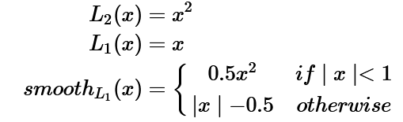
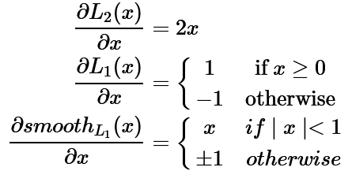
Loss Function
Pixel: L2 & L1 & Smooth L1

Slide 25
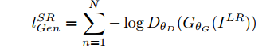
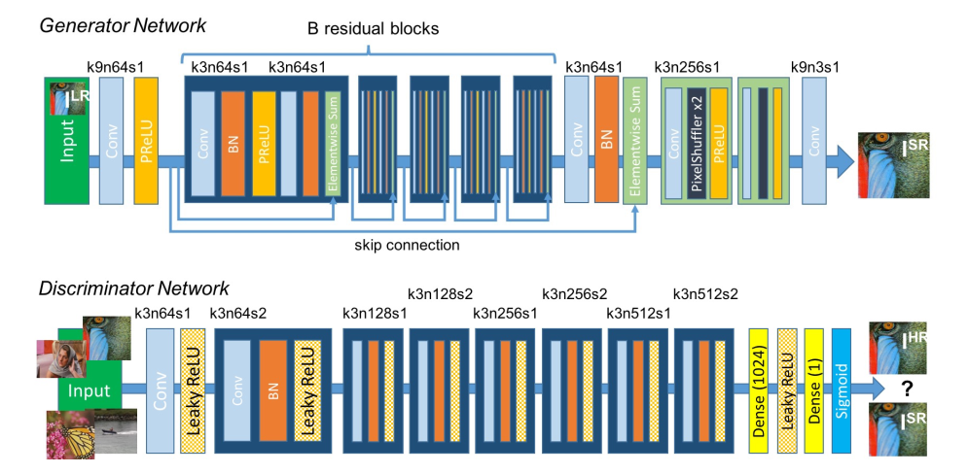
Loss Function
Adversarial Loss
Ledig C, Theis L, Huszár F, et al. Photo-realistic single image super-resolution using a generative adversarial network[C]. IEEE CVPR. 2017

Slide 26
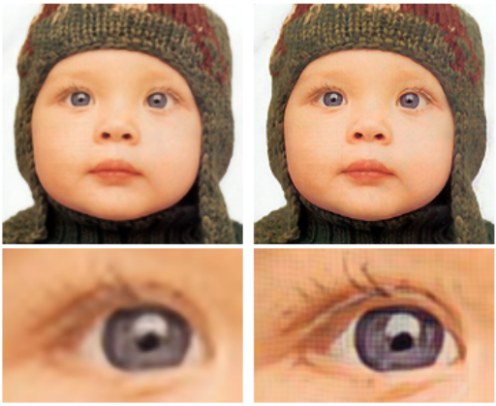
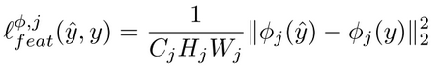
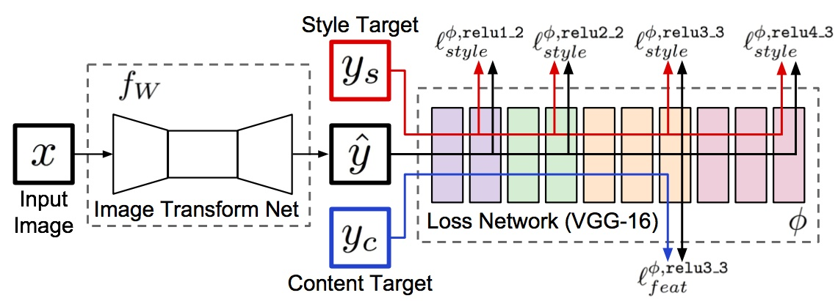
Loss Function
Feature: Perceptual Loss
Johnson J, Alahi A, Fei-Fei L. Perceptual losses for real-time style transfer and super-resolution[C]. ECCV. 2016.

Slide 27
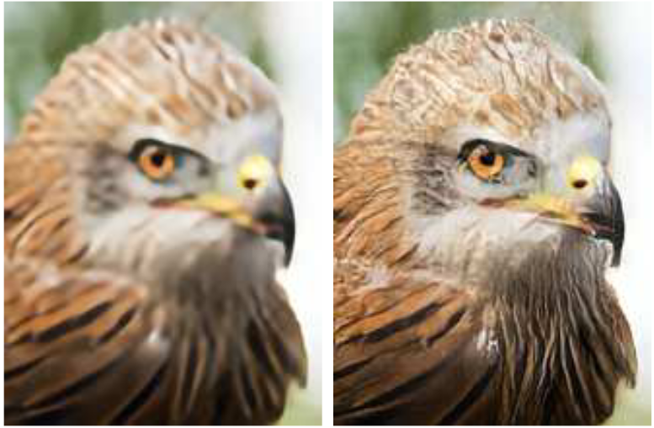
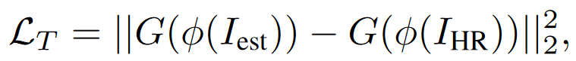
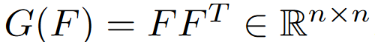

Loss Function
Feature: Texture Loss
$$F∈ℝ^{n×(h∗w)}$$
Calculated on 16x16 patches
Sajjadi M S M, Scholkopf B, Hirsch M. Enhancenet: Single image super-resolution through automated texture synthesis[C]. IEEE ICCV. 2017

Slide 28
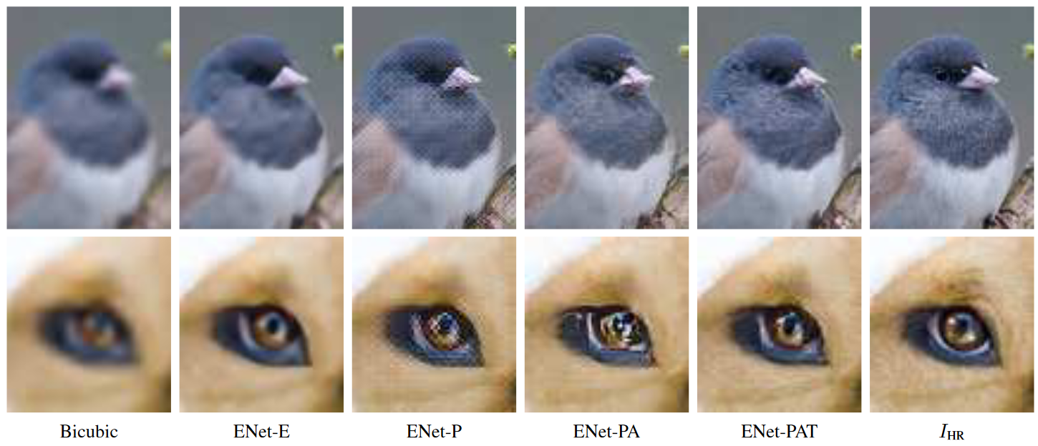
Loss Function
Feature: Texture Loss
Only use perceptual loss
Sajjadi M S M, Scholkopf B, Hirsch M. Enhancenet: Single image super-resolution through automated texture synthesis[C]. IEEE ICCV. 2017

Slide 29
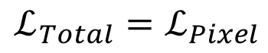

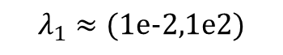
Loss Function
Loss Term Combination
Only For PSNR/SSIM
$$ℒ_{Total}=ℒ_{Pixel}$$
Concerning Visual effects
$$ℒ_{Total}=ℒ_{Pixel}+λ_{1}∗ℒ_{Feature}+λ_{2}∗ℒ_{Adversarial}$$
$$λ_{1}≈(1e−2,1e2)$$
$$λ_{2}≈(1e−4,1)$$

Slide 30
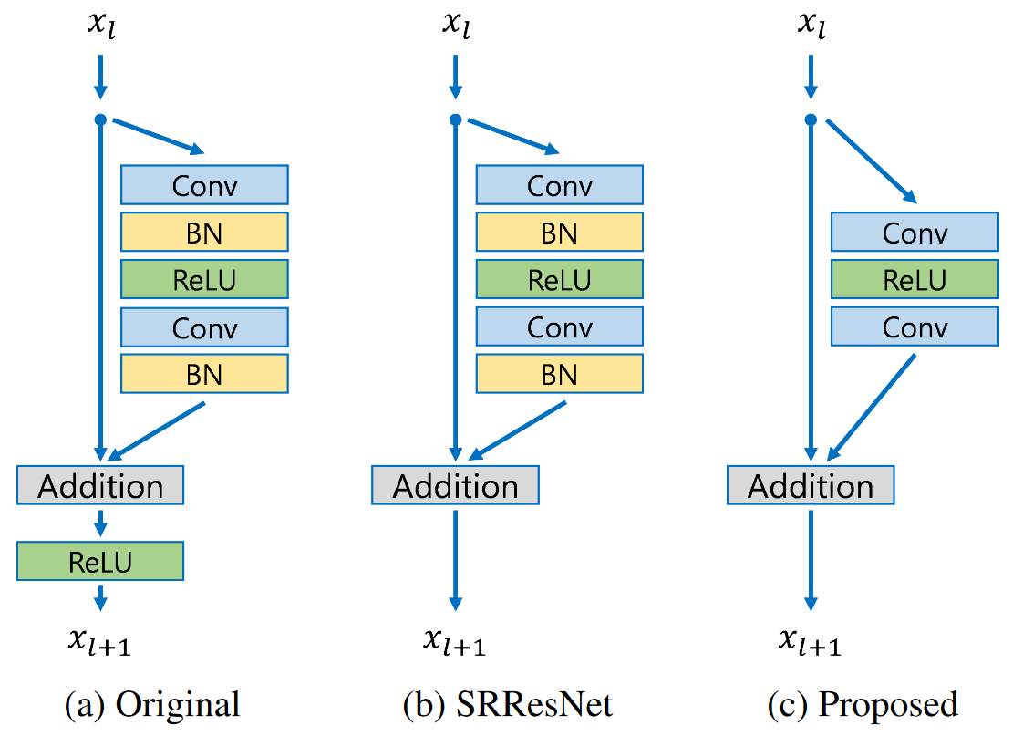
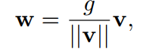

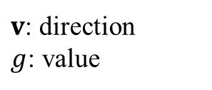
Strategy: Batchnorm or Not?
General Choice for SR
Another Option: Weight Normalization
Weight decomposition
$v$: direction
$g$: value
Update $v$ & $g$ separately
Pro and Con
Better convergence
Larger learning rate 1e-4→1e-3
Sensitive about initialization

Slide 31
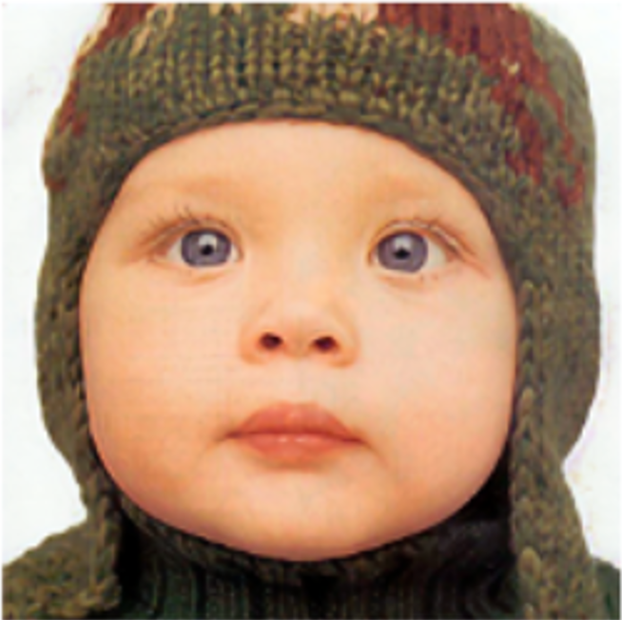
Strategy: Augment & Ensemble
Data Ensemble
Horizontal Flip ?
Vertical Flip ?
Rotate 90 ?
Rectify &
Ensemble
Model

Slide 32
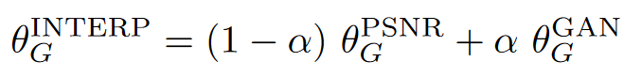
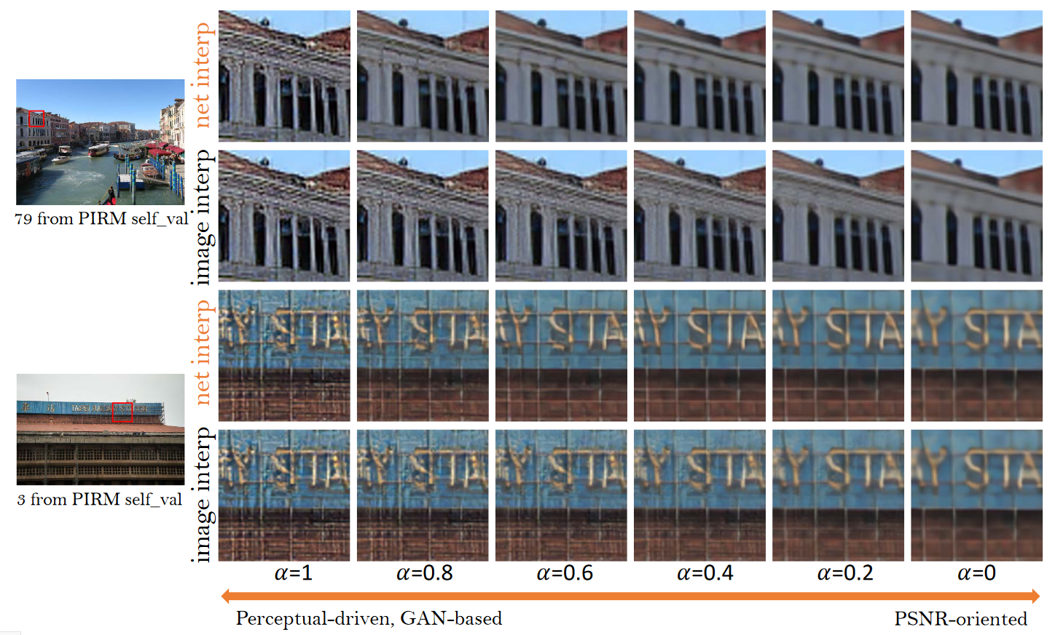
Strategy: Augment & Ensemble
Model Ensemble
Wang X, Yu K, Wu S, et al. ESRGAN: Enhanced super-resolution generative adversarial networks[C]. ECCVW. 2018

